Slide 1
Detection and Classification of Wheat Leaf Diseases Using Deep Convolutional Neural Network
RAKTTIM BISWAS
182-15-11712
SAIF RAKIB HASAN
181-15-10789
MD. ZAHID HASAN
Associate Professor & Associate Head
Department of CSE
Daffodil International University
Saturday 14 May 2022

Slide 2
ROAD MAP
Introduction
Motivation
Research Question
Research Methodology
Research Objective
Result And Future Work
Conclusion

Slide 3
INTRODUCTION
Bangladesh is a developing country where most of its population is directly and indirectly dependent on agriculture. Which contributes 14.10 percent to the country's GDP.
Wheat is the most commonly cultivated crops.
In this thesis paper we have dealt with 5 wheat leaf diseases. These include leaf rust, stripe rust, septoria fungus, tan-spot and stem rust.

Slide 4
MOTIVATION
Most of our economic assistance to Bangladesh comes from agriculture.
The use of ICT in agriculture in our country is very negligible.
Traditional methods are very complicated to detect the problems and find out the possible solutions in this sector.
Know about the new diseases and insects through blogs and books are difficult for farmers.
AI and Machine Learning will help the farmers to detect insects easily and perfectly

Slide 5
RESEARCH QUESTION
 | Description
RQ1 | What is the current situation of farmers and the application of AI in the field of agriculture in Bangladesh?
RQ2 | What are the limitations to work with AI in the agricultural sector to detect disease?
RQ3 | How to solve the limitations to detect disease?

Slide 6
DISEASE DATASET
400+
healthy-leaf
350+
leaf-rust
150+
septoria-fungus
120+
stem-rust
240+
stripe-rust
200+
Tan-Spot
There are six categories in this dataset, which contains over Eleven hundred square images. The majority of the photos in this dataset were taken in the field, while others were retrieved via the internet. The worst part was that due of the seasonal issue, manually collecting all of the data from the field was impossible.

Slide 7
RESEARCH METHODOLOGY
In our research paper we use Convolutional Neural Network for Classify in Wheat Leaf Diseases.
We use Five pre-train model which are InceptionV3,ResNet50,VGG16,MobileNetV2 and also use AlexNet. For our work the best fitted mode is InceptionV3.
We also use Image Pre-processing for detect wheat leaf diseases.
In the coding part we use automatic data augmentation part to generate more data to finding more accurate result.

Slide 8
Data Collection
WORK FLOW
Re-size
Background Drop
Enhancement
Data Pre-Processing
Outcome
Data Augmentation
Result
Yes
CNN Model
Test And Train
Evaluation
Recognized
NO

Slide 9
RESEARCH OBJECTIVE
The below are some of the technical objectives:
• Create a reliable model for detecting and classifying wheat leaf disease.
• To encourage software developers to use the concept to work with
Artificial intelligence technology.
• Make the model available in mobile apps and websites. Select the
best machine learning and image processing algorithm for diagnosing disease from leaf images.

Slide 10
RESEARCH OBJECTIVE
The following are some of the agricultural goals:
• Assist farmers in identifying undiscovered leaf diseases.
• Make farmers self-sufficient.
• Lower the cost of agricultural treatment.
• Crop production should be increased.
• Will boost the agricultural sector's annual income.

Slide 11
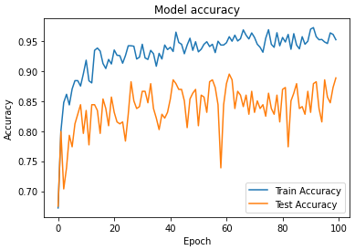
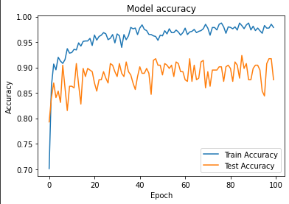
RESULT AND ANALYSIS
In the result part we are using two model MobileNetV2 and InceptionV3 Accuracy of the model is 87.57 percent and 88.85 percent .
Figure 4.1.1 InceptionV3
Figure 4.1.2 MobileNetV2

Slide 12
RESULT AND ANALYSIS
No. of Algorithm | Accuracy | Precision | Recall | F1-Score
InceptionV3 | 0.9628 | 0.8885 | 0.8885 | 0.8885
MobileNetV2 | 0.9586 | 0.8758 | 0.8758 | 0.8758
VGG16 | 0.9469 | 0.8408 | 0.8408 | 0.8408
ResNet50 | 0.7288 | 0.1865 | 0.1865 | 0.1865
AlexNet | 0.7620 | 0.2866 | 0.2866 | 0.2866
By analyzing the results of the five models in our work, we can see that Inception v3 provides the best accuracy for this work. It provides us with 88.85 % accuracy. As a result, the proposed methodologies can be useful for detecting and classifying wheat leaf diseases.

Slide 13
FUTURE WORK
We have a small data set, we have done our best to achieve the highest level of accuracy. This type of effort has the potential to improve Bangladesh's agricultural sector.
Our long-term goal is to develop an android system which can detect disease and provide a more effective antidote.
In future we collect more accurate and high quality data to use them for achieve more Best accuracy to our android apps .

Slide 14
CONCLUSION
The majority of Bangladeshi farmers are illiterate, and thus are unable to correctly identify the disease or know the exact antidote. As a result, the disease gradually kills the harvest day by day, putting farmers at risk. This work has the potential to improve the farmer's position in Bangladesh. This research focuses on utilizing CNN to identify wheat leaf disease on any surface. CNN model is the best model in this types to disease detecting and also classification.

Slide 15


